Slide 1
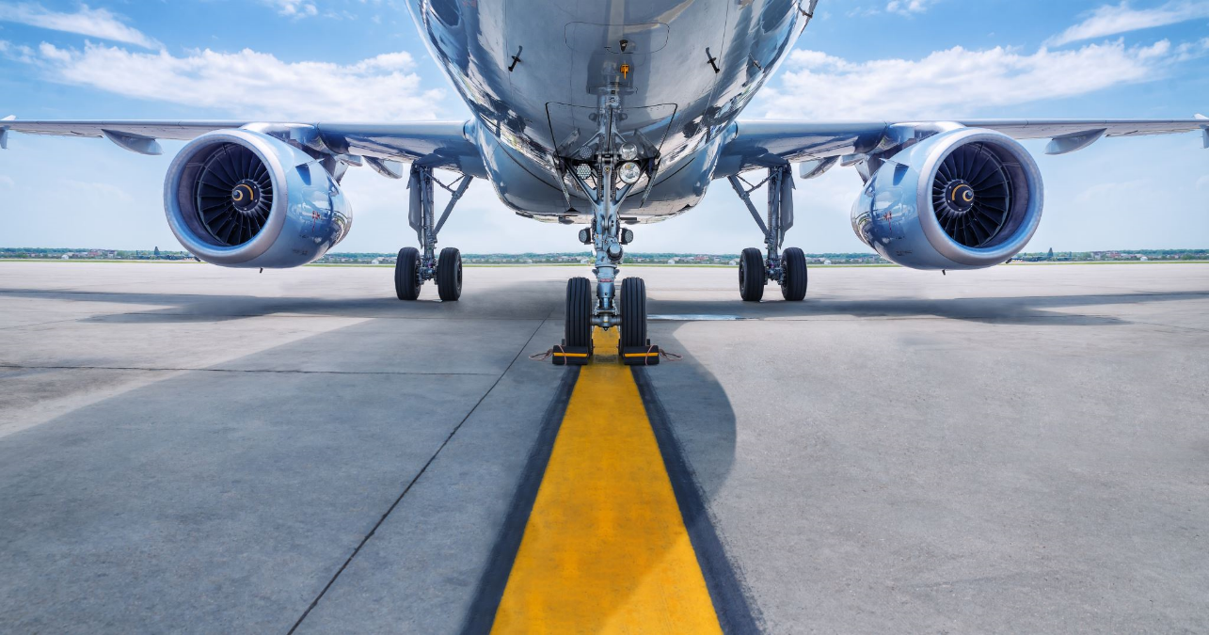
TRANSPO T-17
POLYMER CONCRETE

Slide 2
TRANSPO T-17 POLYMER CONCRETE
Airport runway maintenance is a top concern for Airport managers
Climate, de-icing treatments, and touchdown & taxiing of planes causes distress to runway pavements… over time, this leads to pavement edge cracking, spalling and serious airside safety concerns.

Slide 3
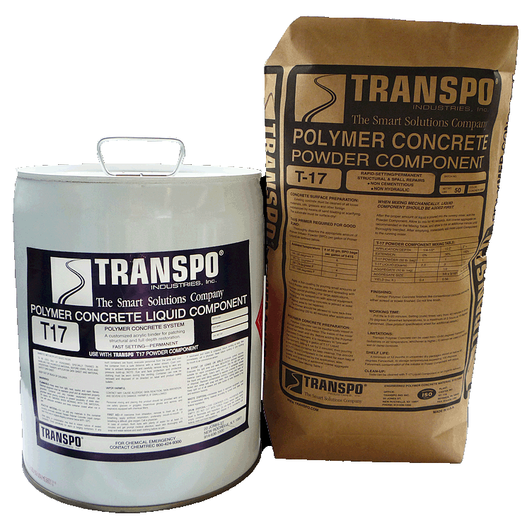
TRANSPO T-17 POLYMER CONCRETE
A high-quality material like Transpo's T-17 is the fastest, easiest, and most cost-effective way to permanently repair these issues.
T-17 uses 100% polymer MMA resin - meaning no mess & no odor
T-17 is highly workable - doesn't shrink to the touch
T-17 is fully cured in less than an hour - lasting indefinitely or until the next scheduled maintenance

Slide 4
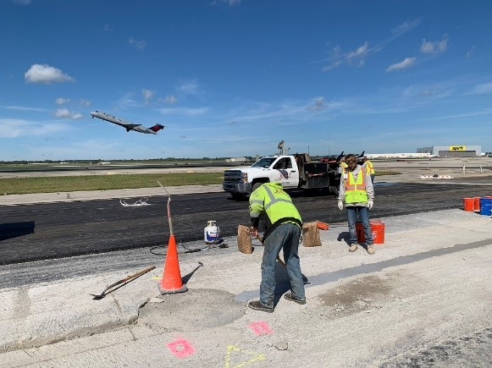
Additional Benefits
TRANSPO T-17 POLYMER CONCRETE
Airports can be operational in 1 hour due to T-17’s high strength, fast-setting solutions processes
Shallow or full-depth repairs can be made at temperatures below zero (because no water is used).

Slide 5
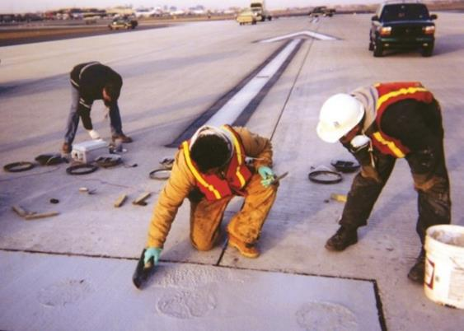
Additional Benefits
TRANSPO T-17 POLYMER CONCRETE
Polymer resin-based mix provides superior bond strength and eliminates any concerns about shrinkage or cracking.

Slide 6
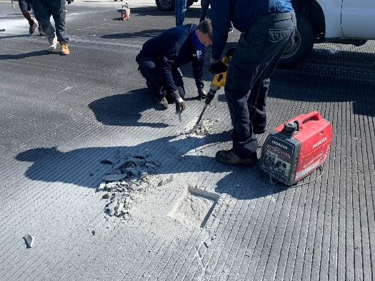
Additional Benefits
TRANSPO T-17 POLYMER CONCRETE
No special tools, equipment or trades needed. Apply T-17 as:
Neat mortar for grouting
Thin patches
Extended with prepackaged aggregate
Partial and full depth patching

Slide 7
Additional Benefits
TRANSPO T-17 POLYMER CONCRETE
Wide Application Temperature Range
(14-100°F, subzero additives available)
Fast Setting (45 min. at 70°F)
High Early Strength (5,000 psi, minimum @ 90 minutes)
Strong Chemical Bond (no cold joints)
Chemical Resistant
UV Light Resistant
Freeze-Thaw Resistant

Slide 8
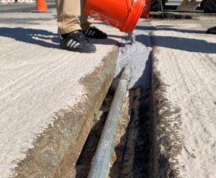
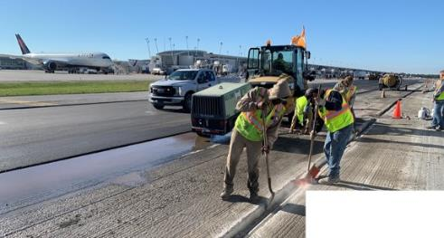
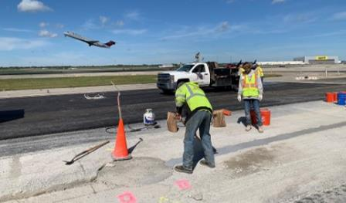
T-17 used at Detroit Metro McNamara Terminal Ramps
TRANSPO T-17 POLYMER CONCRETE
Conduit Trench Fill for HMA Paving

Slide 9
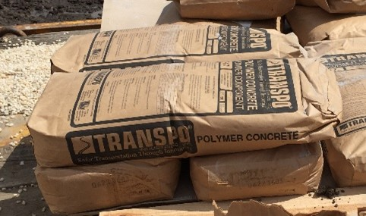
T-17 at current Airports
TRANSPO T-17 POLYMER CONCRETE
DETROIT
DALLAS FORT WORTH
LAGUARDIA
JFK
NEWARK
LOVE FIELD
ORLANDO

